Slide 1
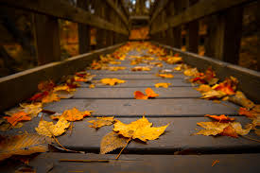
Daily Review
Reminder
Move to find the resources they need Respond to changes in their environment Grow as they get older Reproduce to make new individuals Excrete waste products from their bodies Exchange gases with their environment Nutrition from food and water
Identifying living, non-living and dead
Identify which characteristics the object has. Does it have all 7 characteristics? = living Does it have none, but once had all 7 characteristics = dead Does it have some or none, but never had all 7 = non-living
Is a fallen leaf living, non-living or dead? Explain your choice

Slide 2
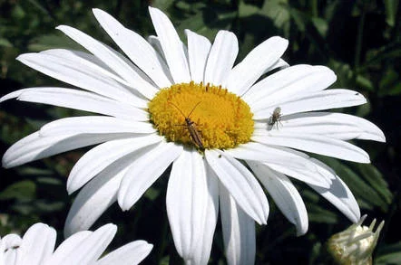
Daily Review
Reminder
Move to find the resources they need Respond to changes in their environment Grow as they get older Reproduce to make new individuals Excrete waste products from their bodies Exchange gases with their environment Nutrition from food and water
Identifying living, non-living and dead
Identify which characteristics the object has. Does it have all 7 characteristics? = living Does it have none, but once had all 7 characteristics = dead Does it have some or none, but never had all 7 = non-living
Is a daisy living, non-living or dead? Explain your choice

Slide 3
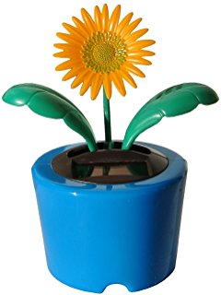
Daily Review
Reminder
Move to find the resources they need Respond to changes in their environment Grow as they get older Reproduce to make new individuals Excrete waste products from their bodies Exchange gases with their environment Nutrition from food and water
Identifying living, non-living and dead
Identify which characteristics the object has. Does it have all 7 characteristics? = living Does it have none, but once had all 7 characteristics = dead Does it have some or none, but never had all 7 = non-living
Is a dancing flower living, non-living or dead? Explain your choice

Slide 4
Microscopes

Slide 5
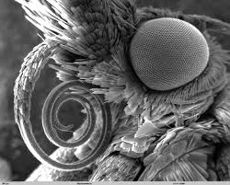
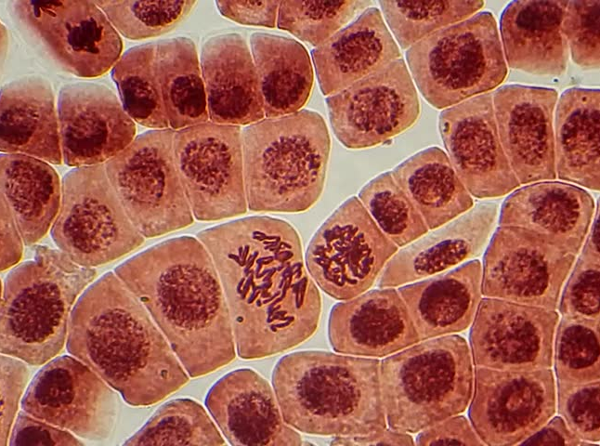
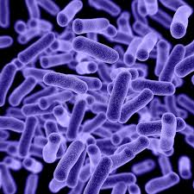
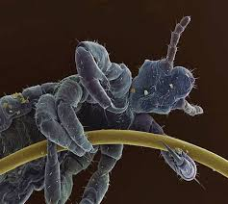
Learning Objective
CFU
What are we going to learn?
Name the parts of a microscope
Identify the function of each microscope part
Describe how to use a microscope safely
Activate Prior Knowledge
Microscopes are used to see small objects.
Think, Pair, Share: What is shown in each of these images?
Butterfly head
Plant cells
Bacteria
Head louse
Notes:
Butterfly, plant cells, bacteria, head louse

Slide 6
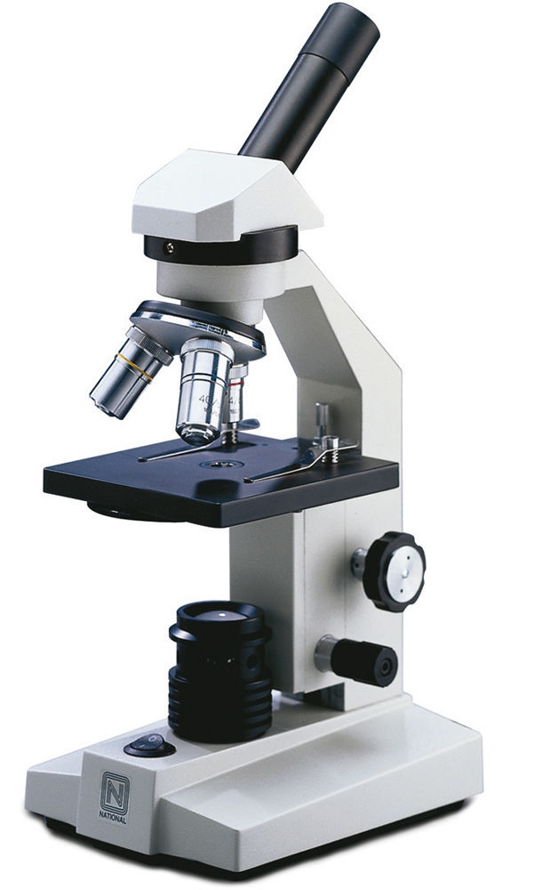
Concept Development
CFU 1
What does the word magnify mean?
Microscope
A microscope is a device that uses lenses to magnify an object
The word microscope is a combination of two words:
Micro meaning small
-scope meaning to view or look at
CFU 2
What does a microscope do?
CFU 3
Where does the word microscope come from?
Vocabulary
Magnify: make small objects look bigger

Slide 7
Concept Development
CFU 1
What does a lens do?
CFU 2
How many lenses are there in the microscope?
Parts of a Microscope - Lenses
A lens magnifies an image
There are two lenses in a microscope:
Eyepiece lens – the one you look through
Objective lens – the one nearest the object
CFU 3
How are the two lenses the same?
CFU 4
How are the two lenses different?
Vocabulary
Magnify: make small objects look bigger

Slide 8
Concept Development
CFU 1
What does focusing mean?
CFU 2
How many focus knobs are on the microscope?
Parts of a Microscope - Focusing
There are two focus knobs on a microscope:
Coarse focus – brings the sample into general focus
Fine focus – fine tunes the focus, increases the detail in the image
CFU 3
How is the function of the two focus knobs different?
Vocabulary
Focusing: making an image clear

Slide 9
Concept Development
CFU 1
What is a slide?
CFU 2
What does the stage do?
Parts of a Microscope – Looking at slides
Samples are put on a thin piece of glass called a slide
The stage – holds the slide
Light – shines light through the sample
CFU 3
What is the purpose of the light?
Vocabulary
Focusing: making an image clear

Slide 10
Concept Development
CFU 1
What does focusing mean?
CFU 2
How many focus knobs are on the microscope?
Parts of a Microscope - Support
Some parts are there to support others
Arm – supports the lenses
Base – supports the microscope and holds the light
CFU 3
How are the two lenses the same?
CFU 4
How are the two lenses different?
Vocabulary
Focusing: making an image clear

Slide 11
Skill Development
CFU 1
How should you carry a microscope?
CFU 2
Why do you need to place the microscope on a flat surface?
CFU 3
Which objective lens do you need to use first?
Using a Microscope
1. Carry the microscope with two hands.
2. Place the microscope on a flat surface.
3. Make sure the smallest objective lens is in place.
4. Lower the stage and put the slide on it.
5. Looking from the side, raise the stage to the top
6. Look through the eyepiece lens and turn the coarse focus knob until you see an image
7. Use the fine focus knob to sharpen the image
CFU 4
What do you do after changing the objective lens?
CFU 5
How should you raise the stage?
CFU 6
Which focus knob do you use first? Why?
Vocabulary
Focusing: making an image clear

Slide 12
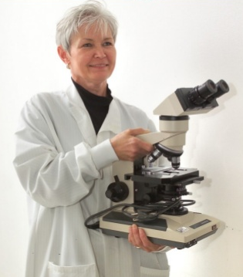
Skill Development/Guided Practice
CFU 1
What is this person doing correctly?
Using a Microscope
Carry the microscope with two hands. Place the microscope on a flat surface. Make sure the smallest objective lens is in place. Lower the stage and put the slide on it Looking from the side, raise the stage to the top Look through the eyepiece lens and turn the coarse focus knob until you see an image Use the fine focus knob to sharpen the image
The correct way to hold a microscope is by using two hands.

Slide 13
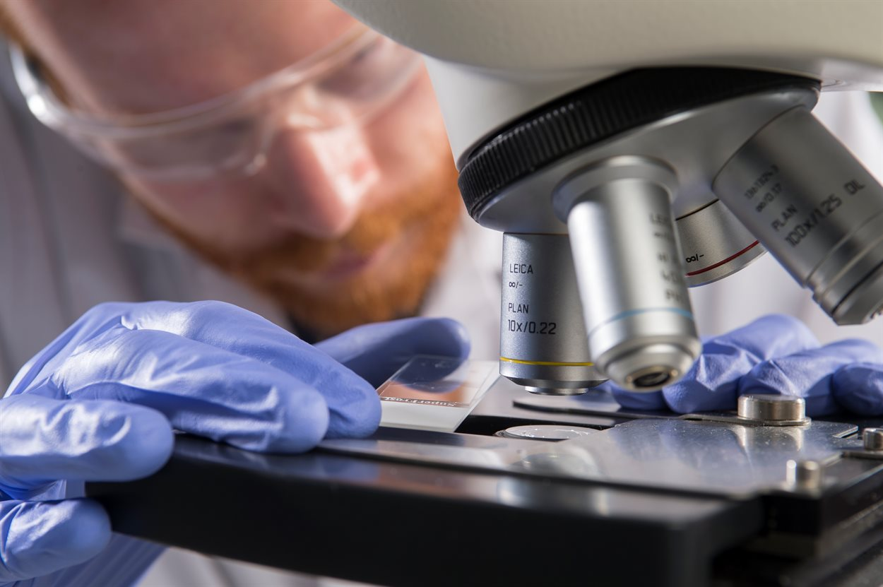
Skill Development/Guided Practice
CFU 1
What is this person doing incorrectly?
Using a Microscope
Carry the microscope with two hands. Place the microscope on a flat surface. Make sure the smallest objective lens is in place. Lower the stage and put the slide on it Looking from the side, raise the stage to the top Look through the eyepiece lens and turn the coarse focus knob until you see an image Use the fine focus knob to sharpen the image
He has not lowered the stage and is not using the smallest objective lens.

Slide 14
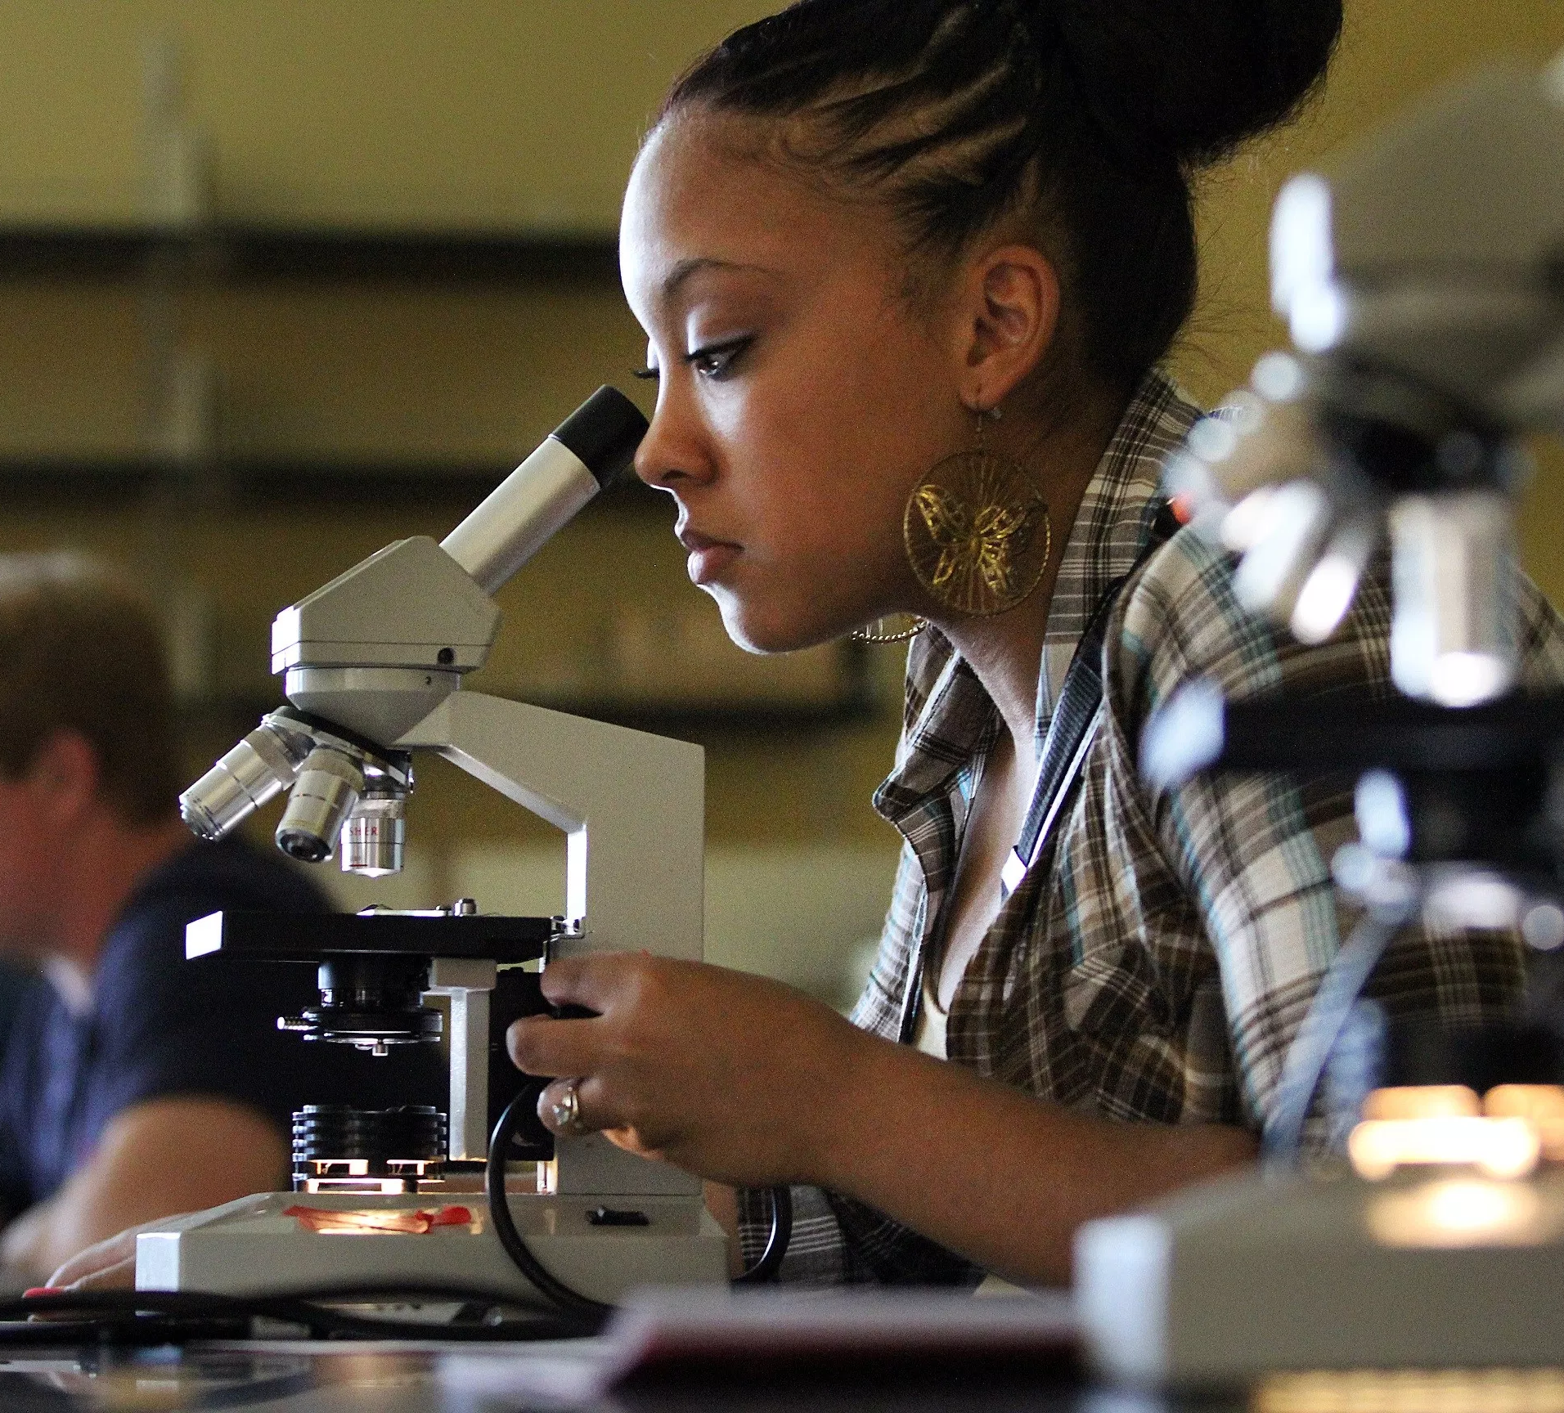
Skill Development/Guided Practice
CFU 1
What is this person doing correctly?
Using a Microscope
Carry the microscope with two hands. Place the microscope on a flat surface. Make sure the smallest objective lens is in place. Lower the stage and put the slide on it Looking from the side, raise the stage to the top Look through the eyepiece lens and turn the coarse focus knob until you see an image Use the fine focus knob to sharpen the image
She is using the smallest objective lens and is moving the stage from the top downwards.

Slide 15
Relevance
Biology is the study of living things and what it means to be alive.
You will soon be looking at cells and body systems, which allow living things to function.
Microscopes are used to look at cells of plant and animals

Slide 16
Skill Closure
What are the names of the two lenses in a microscope?
Skill Closure
How should you carry a microscope?
Skill Closure
Which objective lens should you use when setting up your microscope? The smallest or the largest?
Skill Closure
Which focus knob lets you see the fine detail in the image?

Slide 17
Independent Practice
Complete the first two pages of the worksheet called Using the Microscope.

